Slide 1

PEISS
Power-Efficient Infrared Security System
Carlos Granja Angulo - Photonics Science Engineering
Matthew Berasa - Computer Engineering
Andrew Forde - Electrical Engineering
Andrew Topliffe - Electrical Engineering
Group 12 Final Presentation Spring 2025
Notes:
Carlos

Slide 2
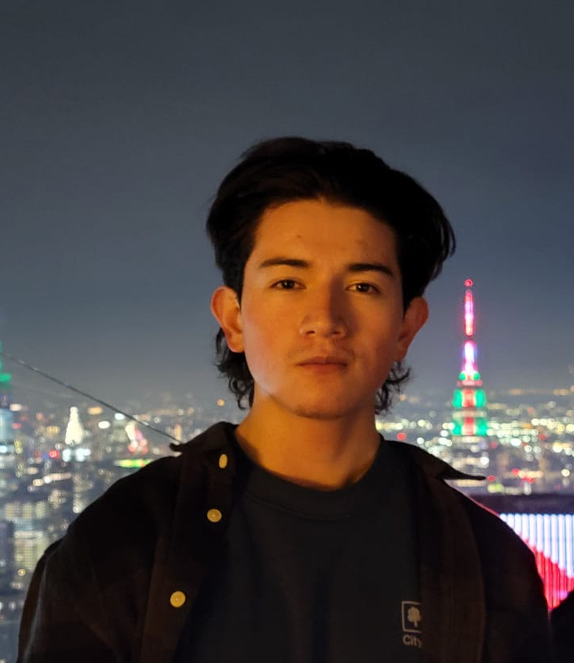


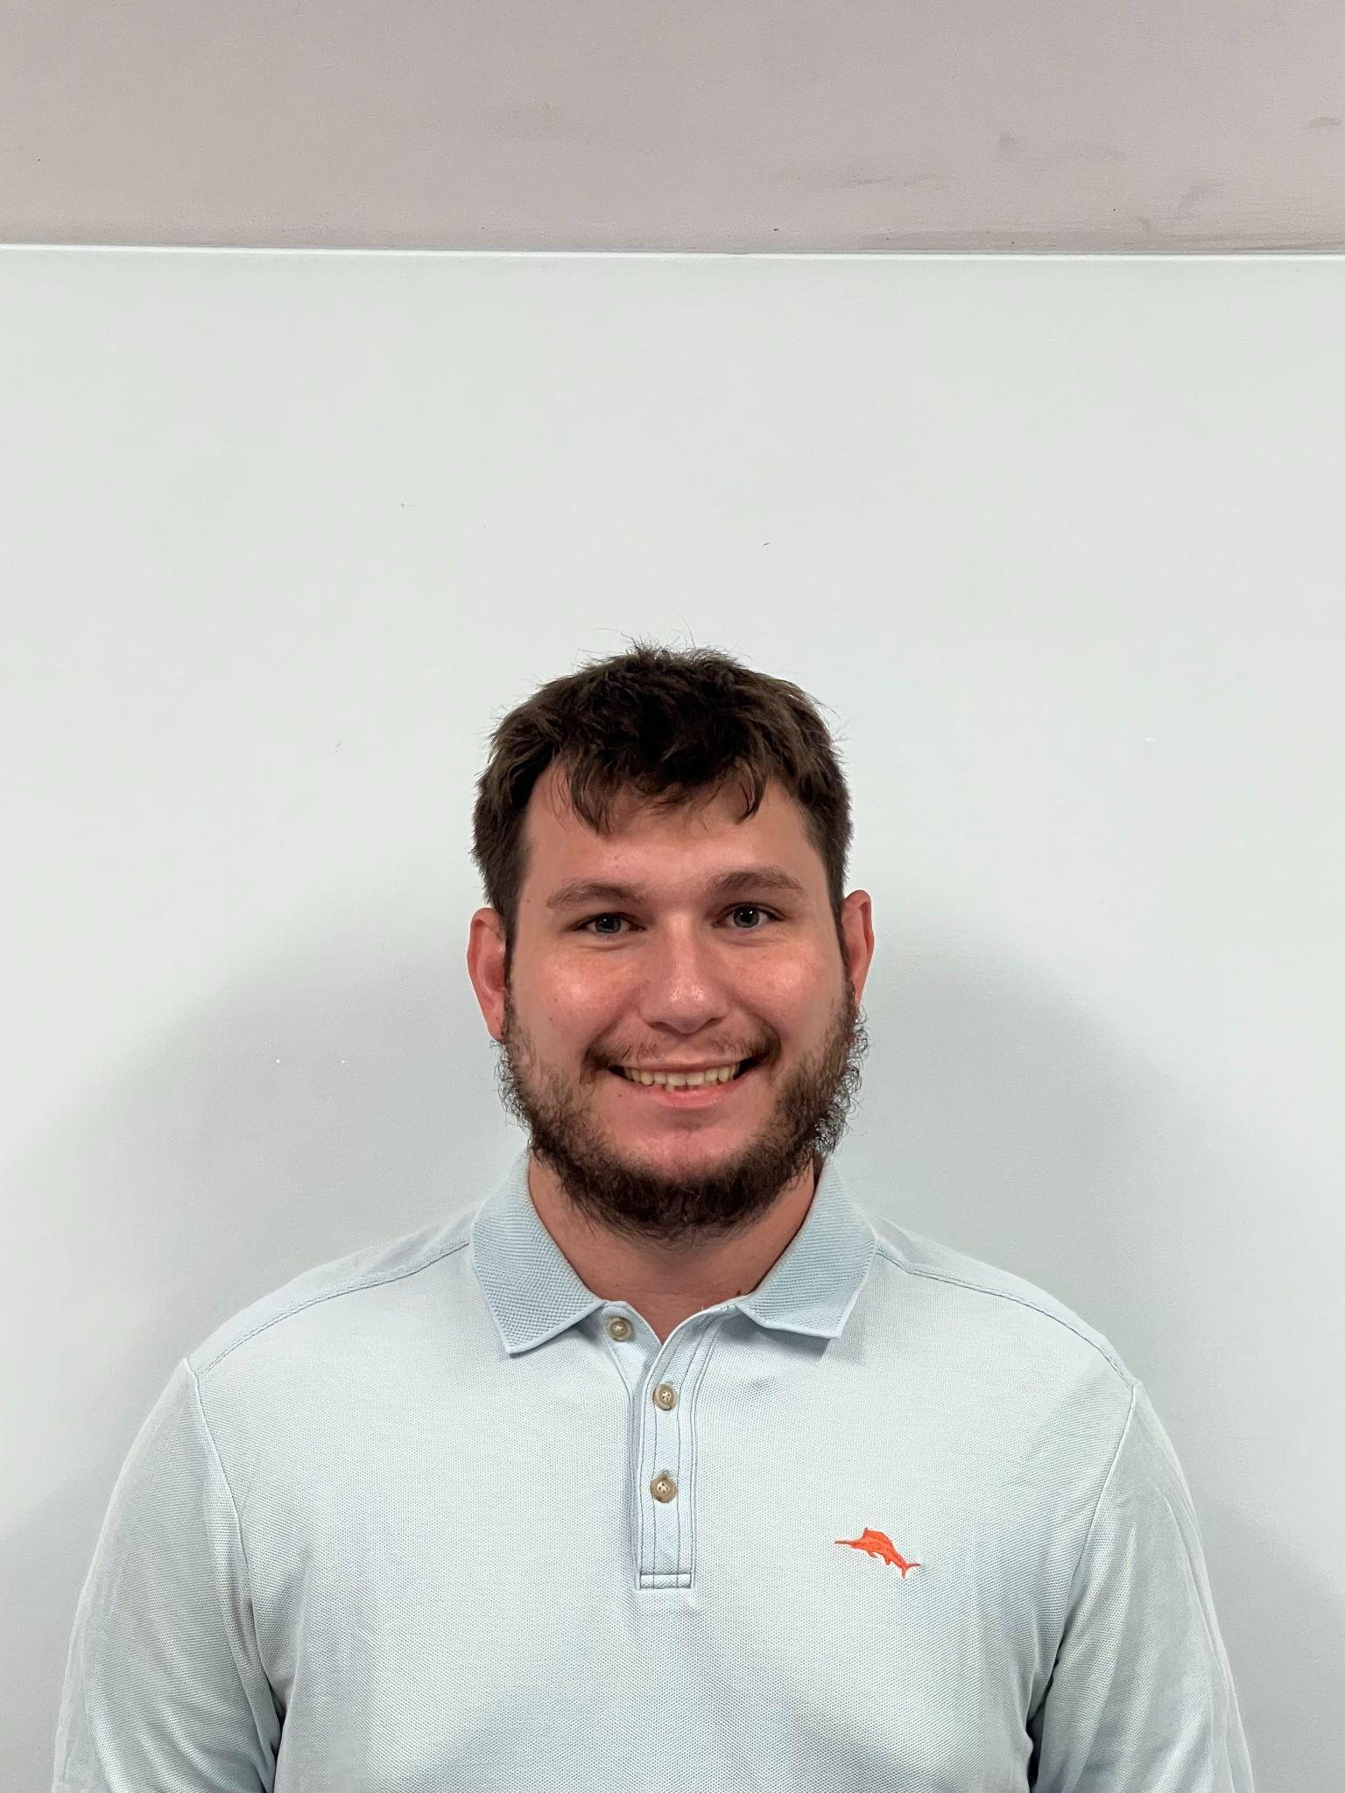
Carlos Granja Angulo - Photonics Science Engineering
Matthew Berasa - Computer Engineering
Andrew Forde - Electrical Engineering
Andrew Topliffe - Electrical Engineering
Notes:
Andrew F

Slide 3
Motivation and Background Background
Power Consumption Comparison:
Traditional security systems require constant high-power operation, typically consuming 5-15W per sensor unit
Camera-based systems with continuous recording can consume 15-30W per camera
PIR (Passive Infrared) sensors use less power but have higher false alarm rates
The LED-photodiode system has lower power consumption because:
LEDs are inherently energy-efficient light sources
Photodiodes require minimal power to operate
The processing can be optimized for minimal power usage
Regarding price comparisons:
Traditional CCTV systems typically cost $500-2000 per installation point
Professional PIR-based systems range from $200-1000 per sensor
High-end smart security systems can cost $1000-3000 for basic setups.

Slide 4
Goals and Objectives
BASIC:
Design an energy-efficient LED-Photodiode system through component selection
Develop high-speed detection with streamlined circuit layouts.
Create robust signal processing algorithms with specific wavelength selections and filtering techniques
Design a comprehensive mobile application with user interface elements and real-time data handling
Implement an AC power supply system with conversion circuits and voltage regulation systems
ADVANCED:
Design and integrate camera capture capabilities with efficient triggering mechanisms
Develop secure data storage solutions with encryption methods and access controls
Create a comprehensive backup power system
Implement wireless control systems with secure communication protocols
STRETCH:
Design advanced detection algorithms for human presence detection and pattern recognition
Develop enhanced range detection capabilities through optical system design
Create multiple LED-photodiode system with coordination protocols and synchronization methods

Slide 5
Engineering Requirements
Feature | Requirement
Maximum Detection range | At least 2.5 ft
Object detection accuracy | Accuracy of at least 80%
Response Time | Less than 10 seconds
Power consumption | Less than 5W
Backup Power | Rechargeable Battery
Mobile Compatibility | iOS and Android

Slide 6
Optical Specifications
Component | Parameter | Specification
LEDs | Field of View | Minimum 40°
 | Wavelength range | 780 - 1000 nm
Photodiode | Field of View | Minimum 40°
 | Wavelength range | 780- 1000 nm
Filter | Center wavelength | 780 - 1000 nm

Slide 7
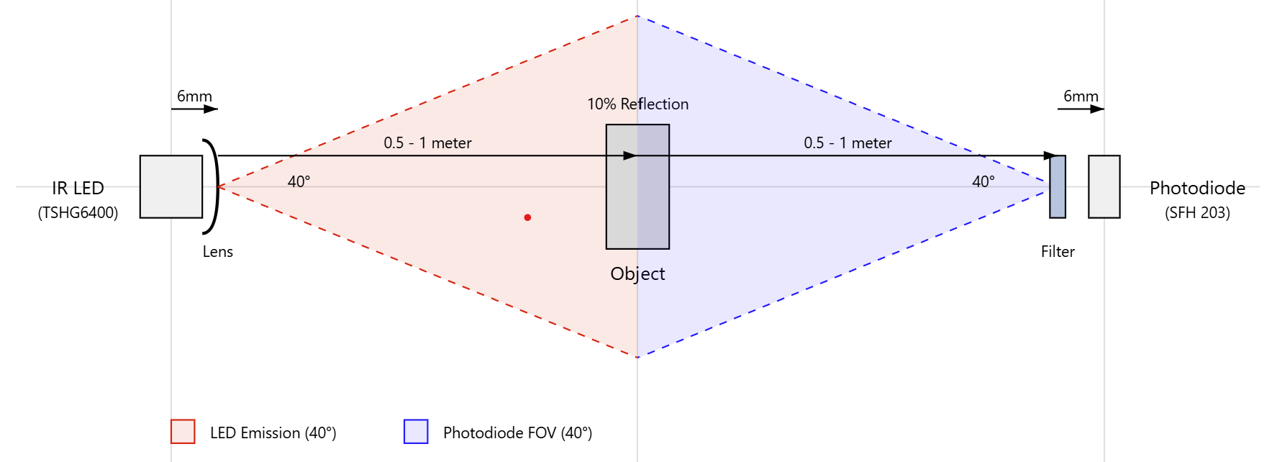
Optical Path
The IR LED will be emitting light that will go through a lens to increase its FOV. Light will travel in free space up to the object for 0.5 - 1 meter.
Reflected light at 10% intensity has to travel back another 0.5 - 1 meter go through filter (blocks ambient light) and be detected by photodiode.

Slide 8
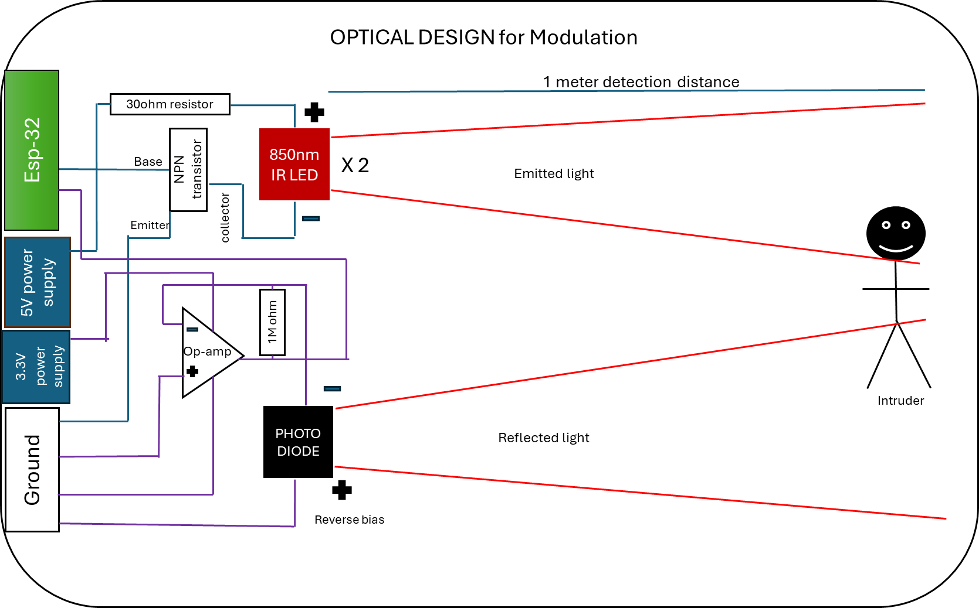
Optical Design and Calculations
After 90% IR Filter:
Normal: 5.01 nW, Dark: 2.01 nW
Photocurrent from Photodiode
Responsivity: 0.62 A/W @ 850nm
Normal: 5.01 nW × 0.62 = 3.11 nA
Dark: 2.01 nW × 0.62 = 1.24 nA
LEDs @ 850nm, 700 mW/sr each
Quantity: 2 LEDs
Total Power Output:
P = I × Ω = 1400 × 0.0087 ≈ 12.06 mW
Irradiance (at 1m):
E = P / A = 12.06 / 86.29 ≈ 0.14 mW/cm²
Reflected Irradiance from Clothing
Normal Clothing:
E(r) = 0.14 × 0.05 = 0.007 mW/cm²
Dark Clothing:
E(r) = 0.14 × 0.02 = 0.0028 mW/cm²
Received Power
Normal Clothing:
E(received) = 0.007 × 0.01 / (4π) ≈ 5.57 nW
Dark Clothing:
E(received) = 0.0028 × 0.01 / (4π) ≈ 2.23 nW

Slide 9
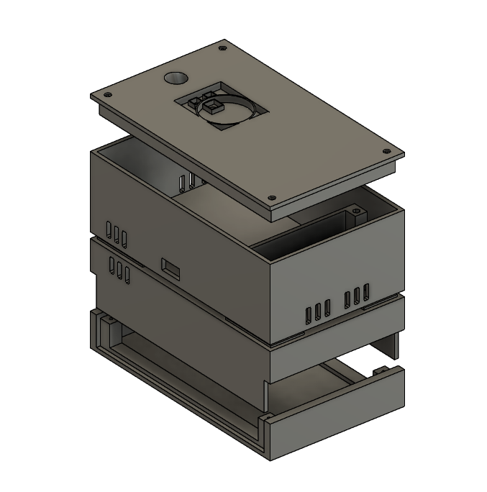
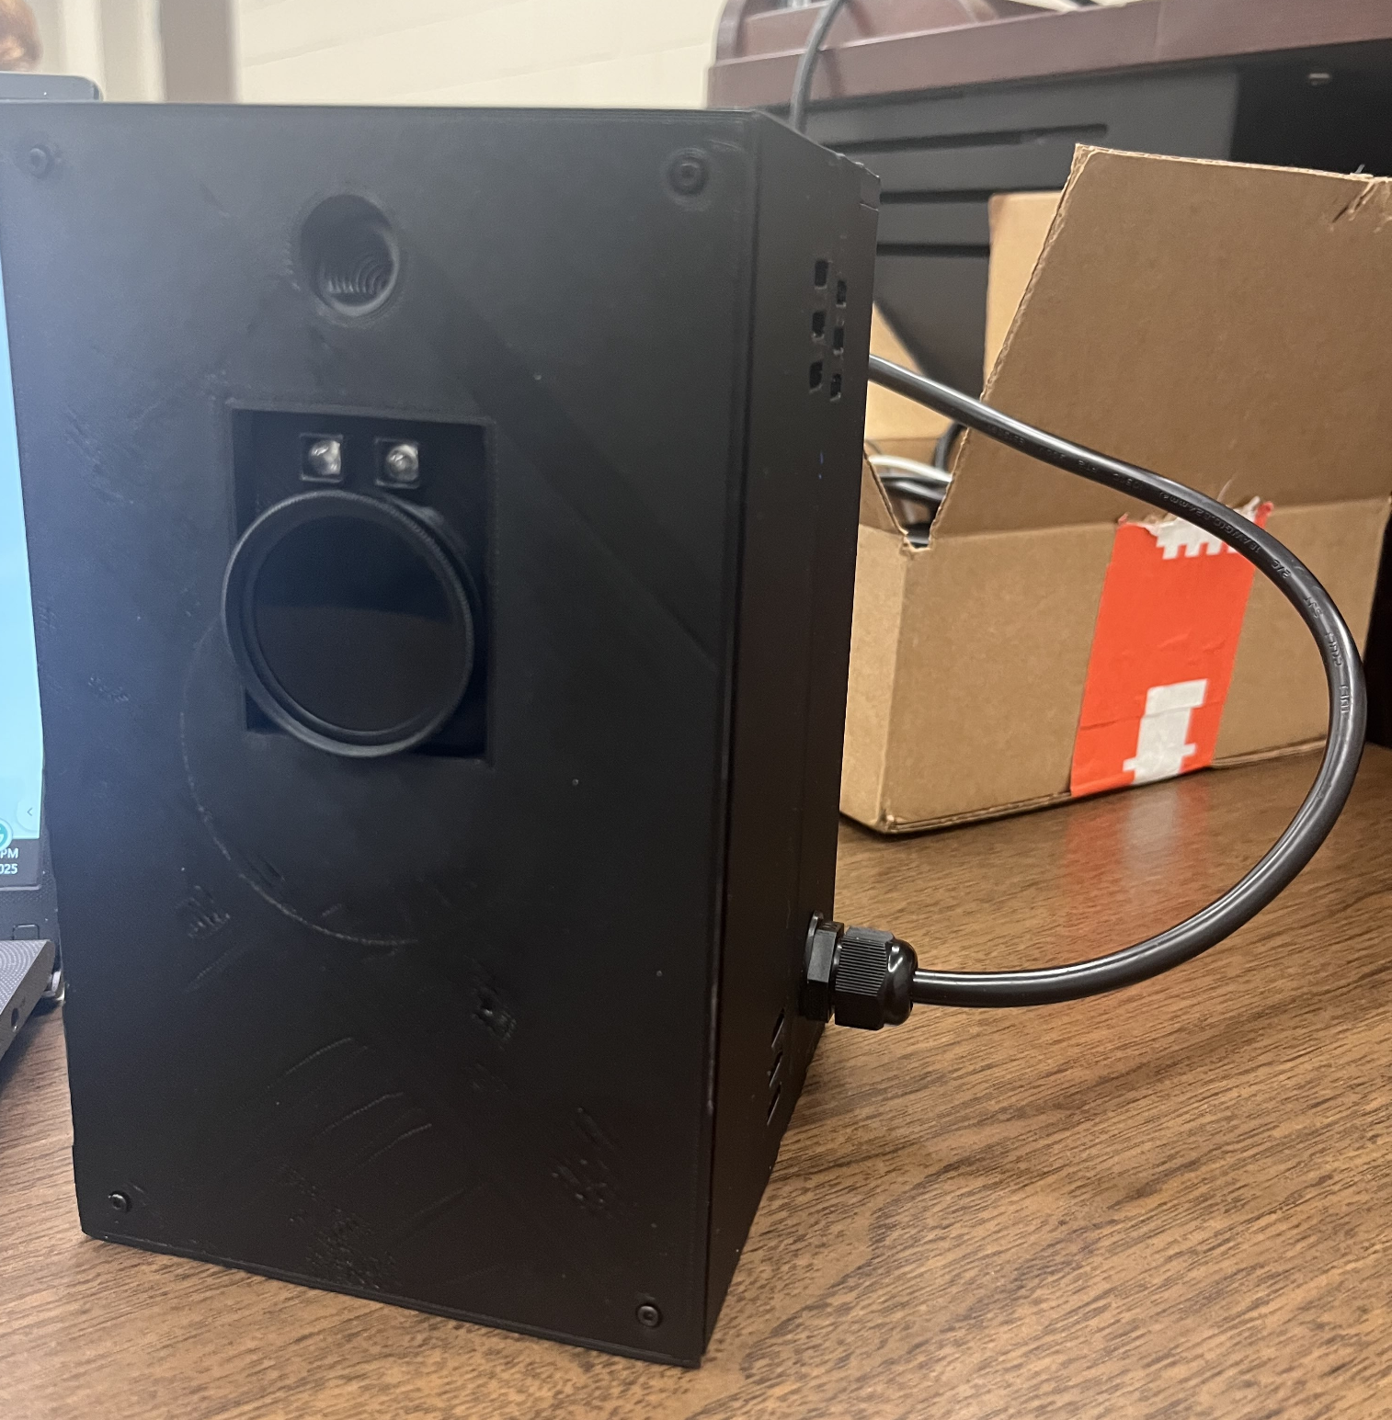
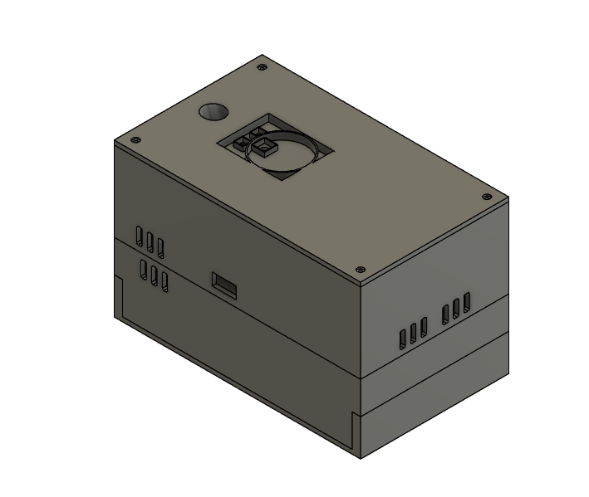
Housing
3D designed housing
3D Printed housing

Slide 10
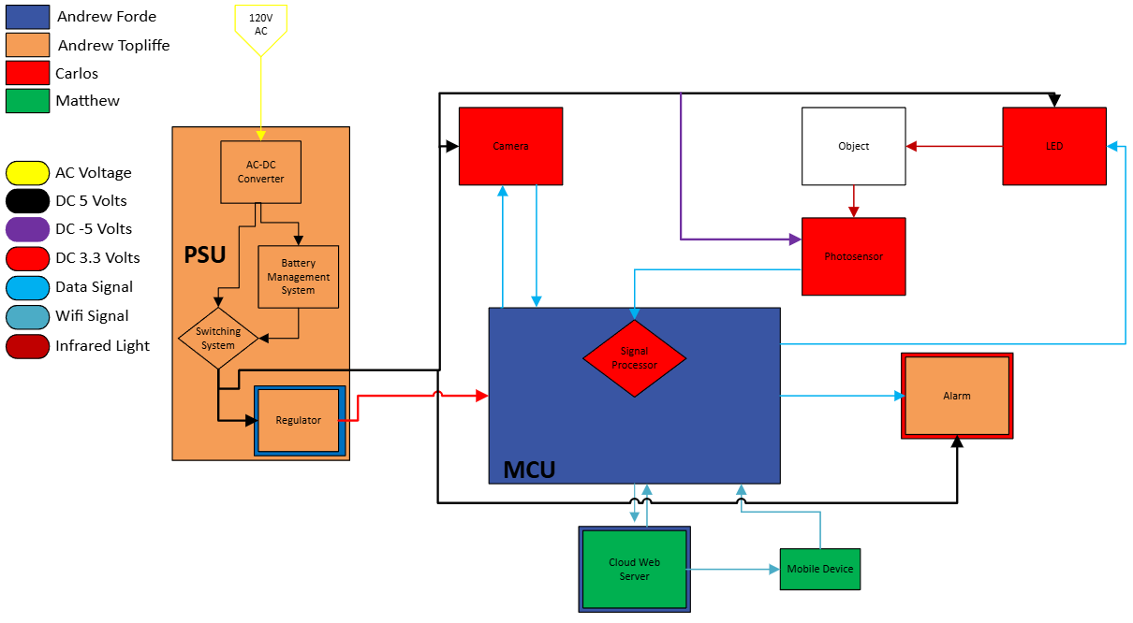
Hardware Diagram
Notes:
Andrew T

Slide 11
Optical System part selection
Technology | Energy Efficiency (mW) | Price Range (USD) | Accuracy | Human Detection | Beam Angle (degrees) | Typical Range (m) | Human Safety
LiDAR | 1000-5000 | 100-500 | Very High | Excellent | 30-360 | 0.1-100+ | Generally Safe
Ultrasonic | 20-100 | 5-50 | Moderate | Limited | 15-60 | 2-10 | Very Safe
PIR | 0.01-0.05 | 2-20 | Low | Limited | 90-360 | 5-12 | Generally Safe
CMOS Camera | 500-2000 | 100-500 | High | Excellent | 60-110 | 10-50+ | Safe
LED-Photodiode | 1-50 | 10-50 | High | Good | 15-60 | 0.1-20 | Very Safe
The LED-Photodiode was selected because of its energy efficiency, low-price and high accuracy.
Notes:
Carlos

Slide 12
LED-Photodiode selection
LED: Selected Vishay for its wavelength which reflects better than 940nm, it's good radiant intensity, and affordability.
Photodiode: Selected SFH 203 for its peak wavelength sensitivity that matches our IR LED, it's good responsibility and low price.
Feature | Vishay TSHG6400 | Everlight IR333-A | OSRAM SFH 4550
Wavelength | 850nm | 940nm | 850nm
Radiant Intensity | 70 mW/sr | 48 mW/sr | 700 mW/sr
Viewing Angle | ±27° | ±20° | ±3°
Price | $0.85 | $0.75 | $0.95
Feature | Everlight PD333-3B/H0/L2 | Osram SFH 203 | Vishay TEMD5510FX01
Spectral Range | 400-1100 nm | 400-1100 nm | 430-1080 nm
Peak Sensitivity | 940nm | 850 nm | 540 nm
Responsivity | 0.5 A/W | 0.62 A/W | 0.65 A/W
Field of View | ±40° | ±20° | ±60°
Price | $0.80 | $0.90 | $1.20
Notes:
Carlos

Slide 13
Filter selection
Filter: Selected Green. L IR filter due to center wavelength, price and peak transmittance. Allow us to block ambient light while maintaining 90% transmittance.
Feature | Thorlabs FB940-10 | Edmund Optics #87-747 | MidOpt BP940 | Green.L 850nm IR Filter
Center Wavelength | 940 ± 2 nm | 950 ± 5 nm | 940 ± 8 nm | 850nm± 30 nm
Peak Transmittance | >90% | >90% | >90% | >90%
Blocking Range | 200-1100 nm | 200-1100 nm | 200-1100 nm | 200-1100 nm
Price (USD) | $95.00 | $49.00 | $35.00 | $20.99
Notes:
Carlos

Slide 14
Camera
Feature | OV2640 | OV5640 | OV7670
Resolution | 2MP (1600x1200) | 5MP (2592x1944) | VGA (640x480)
Interface | SCCB (I2C) | MIPI, DVP | SCCB (I2C)
Power Consumption | ~60mW active | ~140mW active | ~30mW active
Wake-up Time | ~300ms | ~300ms | ~100ms
Low Light Performance | Good | Very Good | Fair
Size | 8.5 x 8.5 mm | 7.1 x 6.5 mm | 8 x 8 mm
Price (Approx.) | $20 | $15 | $5
We choose the OV2640 because it will be able to output an image at a better resolution without consuming much more power than the competitors.
Notes:
Andrew F

Slide 15
Alarm Technology Selection
Magnetic Buzzer was chosen due to it having the loudest dB while at a functioning operating voltage for the system
Alarm | dB Loudness | Size (Diameter) | Operating Voltage | Current Consumption
Piezo Buzzer | 70-85 dB | 10-30 mm | 3-12 V | 5-30 mA
Magnetic Buzzer | 80-100 dB | 10-30 mm | 3-5 V | 30-100 mA
Mini Siren | 110-120 dB | 30 -50 mm | 12 V | 100-500 mA

Slide 16
MCU vs FPGA
MCU Advantages | FPGA Advantages
Cost | Speed
Ease of Use | Reconfigurability
Power Consumption | Hardware Design
Form Factor | Parallel Processing
Embedded Applications | User Control
Due to our project being placing a focal point on power consumption, we decided to go with a MCU over a FPGA.
Notes:
Andrew F

Slide 17
MCU Comparison
Microcontroller | ESP32-WROOM | MSP430 | Arduino Uno R4 | Raspberry Pi Pico W | STM32F4
CPU | Xtensa 32-bit LX6 Dual-Core | 16-bit RISC | 32-bit ARM Cortex-M4 | 32-bit ARM Cortex-M0+ | 32-bit ARM Cortex-M4
Clock Speed | 160-240 MHz | 16 MHz | 48 MHz | 133 MHz | 168 MHz
Memory (Flash and RAM) | 4 MB Flash, 520 KB SRAM | 16 KB Flash, 512 B RAM | 256 KB Flash, 32 KB RAM | 2 MB Flash, 264 KB RAM | 512 KB Flash, 192 KB RAM
GPIO Pins | 48 GPIO Pins | 24 GPIO Pins | 20 GPIO Pins | 26 GPIO Pins | Typically 80 GPIO Pins, can reach up to 114
Communication | UART, SPI, I2C, Wi-Fi, Bluetooth | UART, SPI, I2C | UART, SPI, I2C, USB, Wi-Fi, Bluetooth | UART, SPI, I2C, USB, Wi-Fi, Bluetooth | UART, SPI, I2C, CAN, Ethernet
Operating Voltage | 3.3V | 1.8V-3.6V | 3.3V or 5V | 3.3V | 1.8V-3.6V
USB Support | Yes | No | Yes | Yes | Yes
PWM | Yes | Yes | Yes | Yes | Yes
Cost | $5-$10 - Dev Board $1-$2 - Chip | $11.99 - Dev Board $2.19 - Chip | $27.50 - Dev Board $6.99 - Chip (RA4M1) | $4 - Dev Board $0.70 - Chip (RP2040) | $9.44 - Chip and Dev Board
IoT Capabilities | Yes | No | Yes, with integration | Yes, with integration | No
With IoT capabilities being an emphasis, we were left with three choices out of the 5. Out of the three the ESP32 was the strongest performer.
Notes:
Andrew F

Slide 18
Power Requirements for Hardware
All hardware components in parallel of each other
Absolute max current ~950mA
Hardware | Model | Voltage | Current | Quantity | Total Power
MCU | ESP32 | 3.3V | ≤ 600mA | 1 | 1.98W
Camera | OV2640 | 5V | 70mA active | 1 | 350mW active
Alarm | CMT-8540S-SMT-TR | 5V | 150mA | 1 | 750mW
LED | TSHG6400 | 5V | 100mA | 2 | 1W
Relay Coil | J104B2C5VDC.20S | 5V | 40mA | 1 | 200mW
Total |  |  | ~950mA |  | 4.28W

Slide 19
Power Converter
The IMR-15-5 was chosen for its current output and low cost
Model | IMR-15-5 | IMR-03-5 | RAC10-05SK/277 | RAC04-05SC/277
Input Voltage | 85 ~ 305 VAC, 120 ~ 430 VDC | 85 ~ 305 VAC, 120 ~ 430 VDC | 80 ~ 305 VAC | 80 ~ 305 VAC
Output Current | 3A | 600mA | 2A | 800mA
Power | 15W | 3W | 10W | 4W
Package/ Case | 4-DIP Module | 26-SMD Module, 14 Leads | 4-DIP Module | 7-DIP Module, 6 Leads
Cost | $9.73 | $6.10 | $13.04 | $21.86
Notes:
Andrew T

Slide 20
Batteries
18650 has the best capacity, cost, and safest batteries for recharging
Model | 18650 | 2011 | BL3000F9031781S1PCNC | BGN2500
Chemistry | Li-Ion | Lithium-Ion Polymer | Lithium-Ion Polymer | Nickel Cadmium
Output Voltage | 3.7V | 3.7 V | 3.7 V | 1.2 V
Capacity | 3.4Ah | 2Ah | 3Ah | 2.5Ah
Cost | $6.95 | $12.50 | $19.26 | $4.61
Notes:
Andrew T

Slide 21
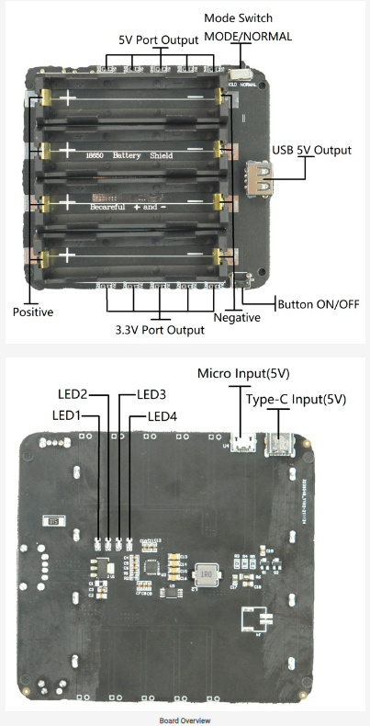
Battery Management System
DFR0969 4-way 18650 battery holder by DFRobot
built in overcharge and over-discharge protection
outputs at 5V 2A and 3.3V 1A.
We will only be using the 5V output for simplicity
Notes:
Andrew T

Slide 22
Priority Switching System
Switching between two power sources can be achieved by the use of a relay
Main source powering relay and in NO position, backup source in NC position
Loss of main source causes relay to switch position, allowing backup source to be used
Model | 3385-AZ943-1CH-5DE-ND | ALQ105 | J104B2C5VDC.20S | JW2SN-DC5V
Max current | 10 A | 5 A (30 V DC) | 3 A | 5 A
Contact Configuration | SPDT (1 Form C) | SPDT (1 Form C) | DPDT (2 Form C) | DPDT (2 Form C)
Coil voltage | 5V DC | 5V DC | 5V DC | 5V DC
Cost | $1.09 | $1.45 | $1.77 | $2.97
Notes:
Andrew T

Slide 23
Power Regulation
To ensure a stable 3.3V from the PSU, a regulator will be used
A switching regulator will be used instead of linear regulator
Model | LM2596-ADJ | LMR50410Y3FQDBVRQ1 | LM2575T-3.3/NOPB | LT8609AEDDM-3.3#PBF
Input Voltage Range | 4.5V-40V | 4V-36V | 4V-40V | 3V-42V
Output Current | 3A | 1A | 1A | 3A
Switching Frequency | 150kHz | 2.1MHz | 52kHz | 200kHz ~ 2.2MHz
Efficiency | 73% | 88% | 75% | 80%
Cost | $6.70 | $1.41 | $3.58 | $8.94
Notes:
Andrew T

Slide 24
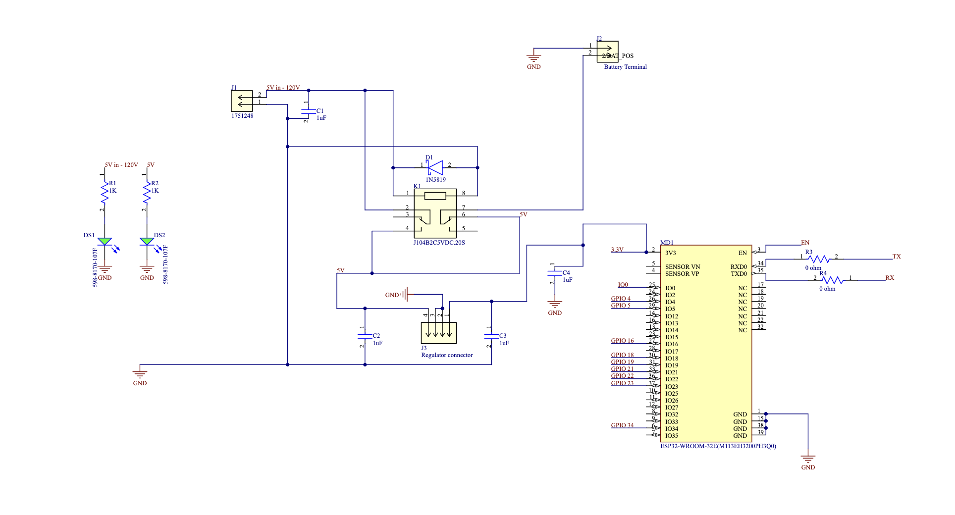
Switching System Schematic
Notes:
Andrew T

Slide 25
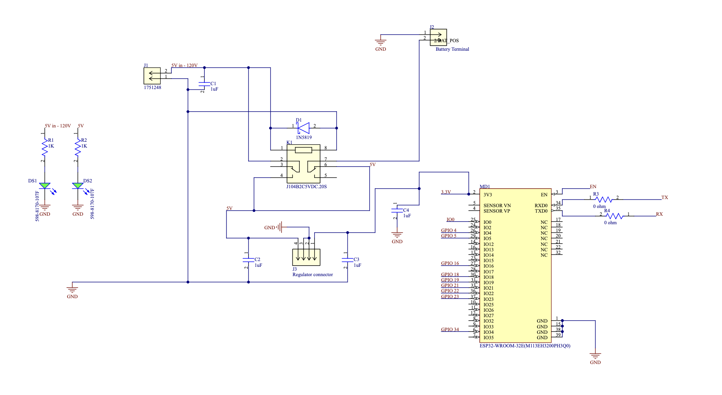
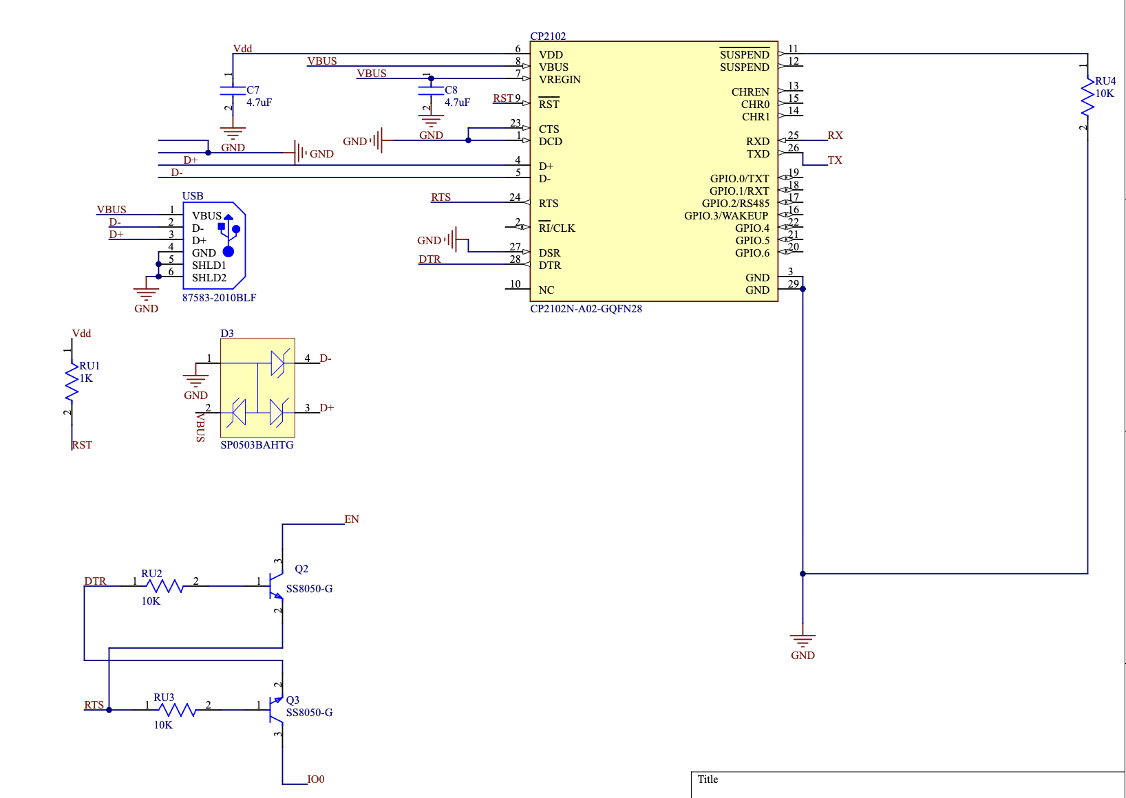
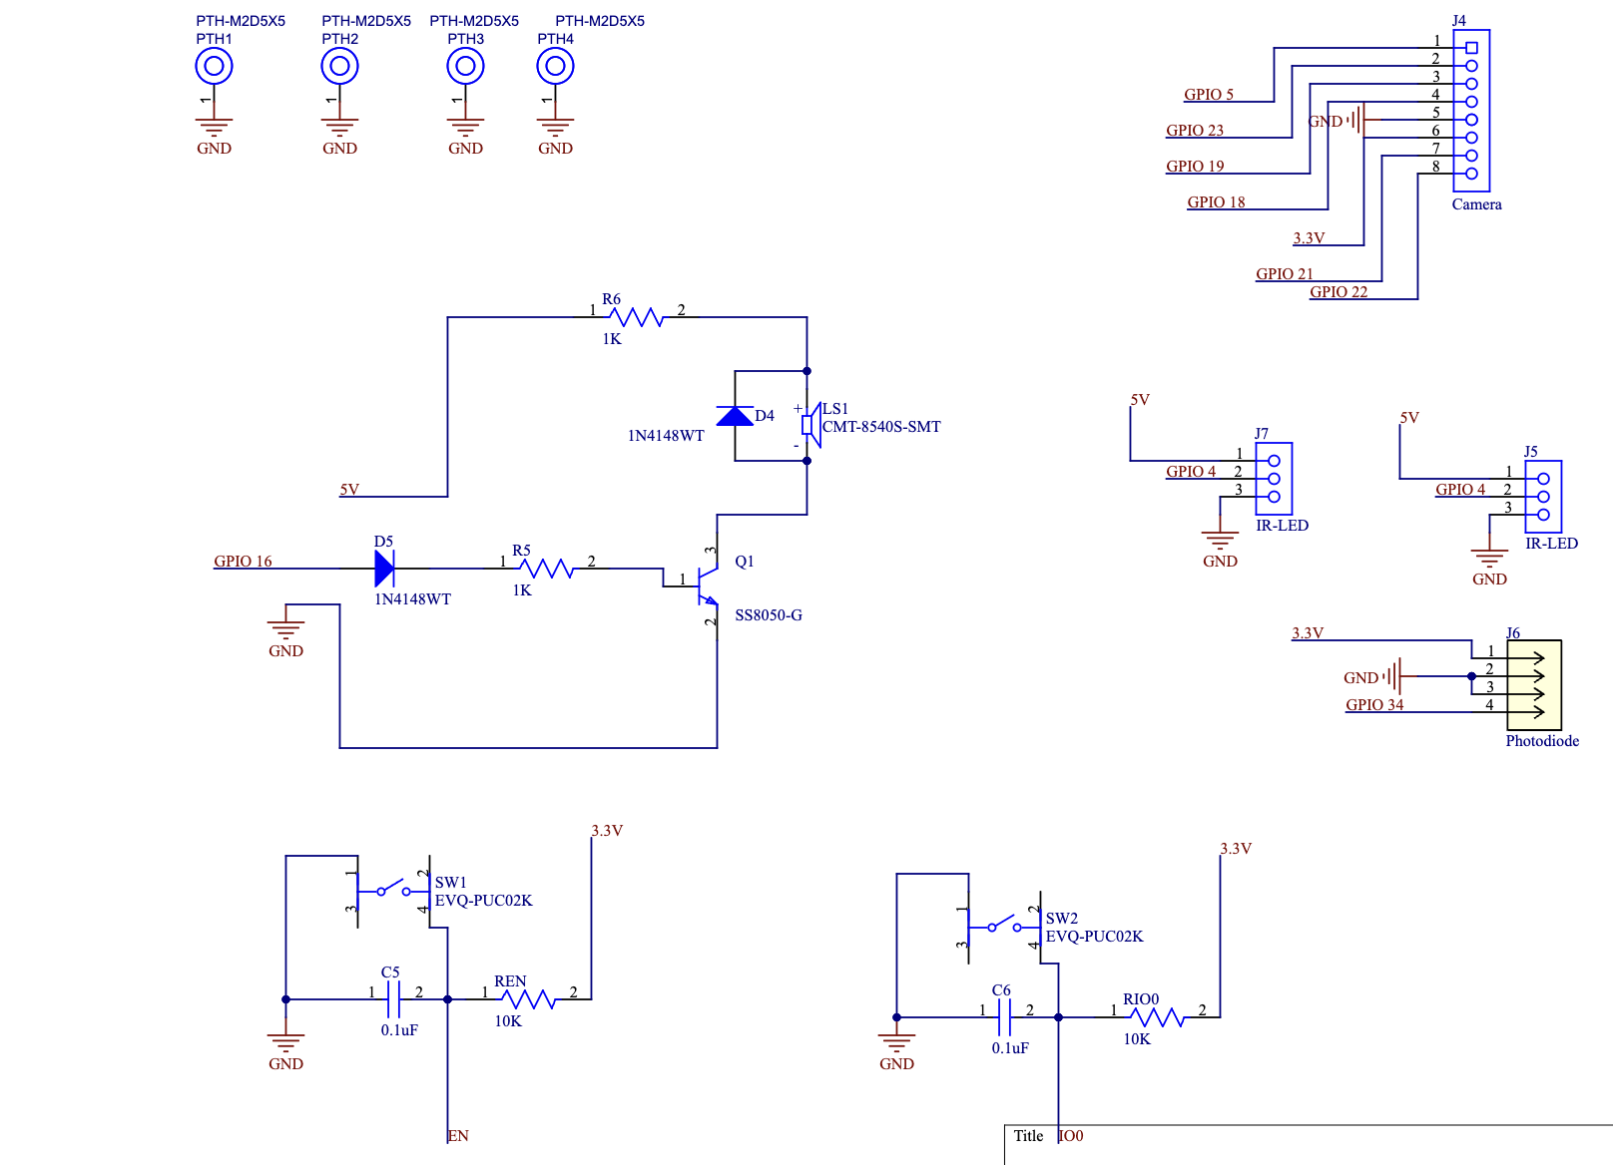
Main PCB schematic

Slide 26
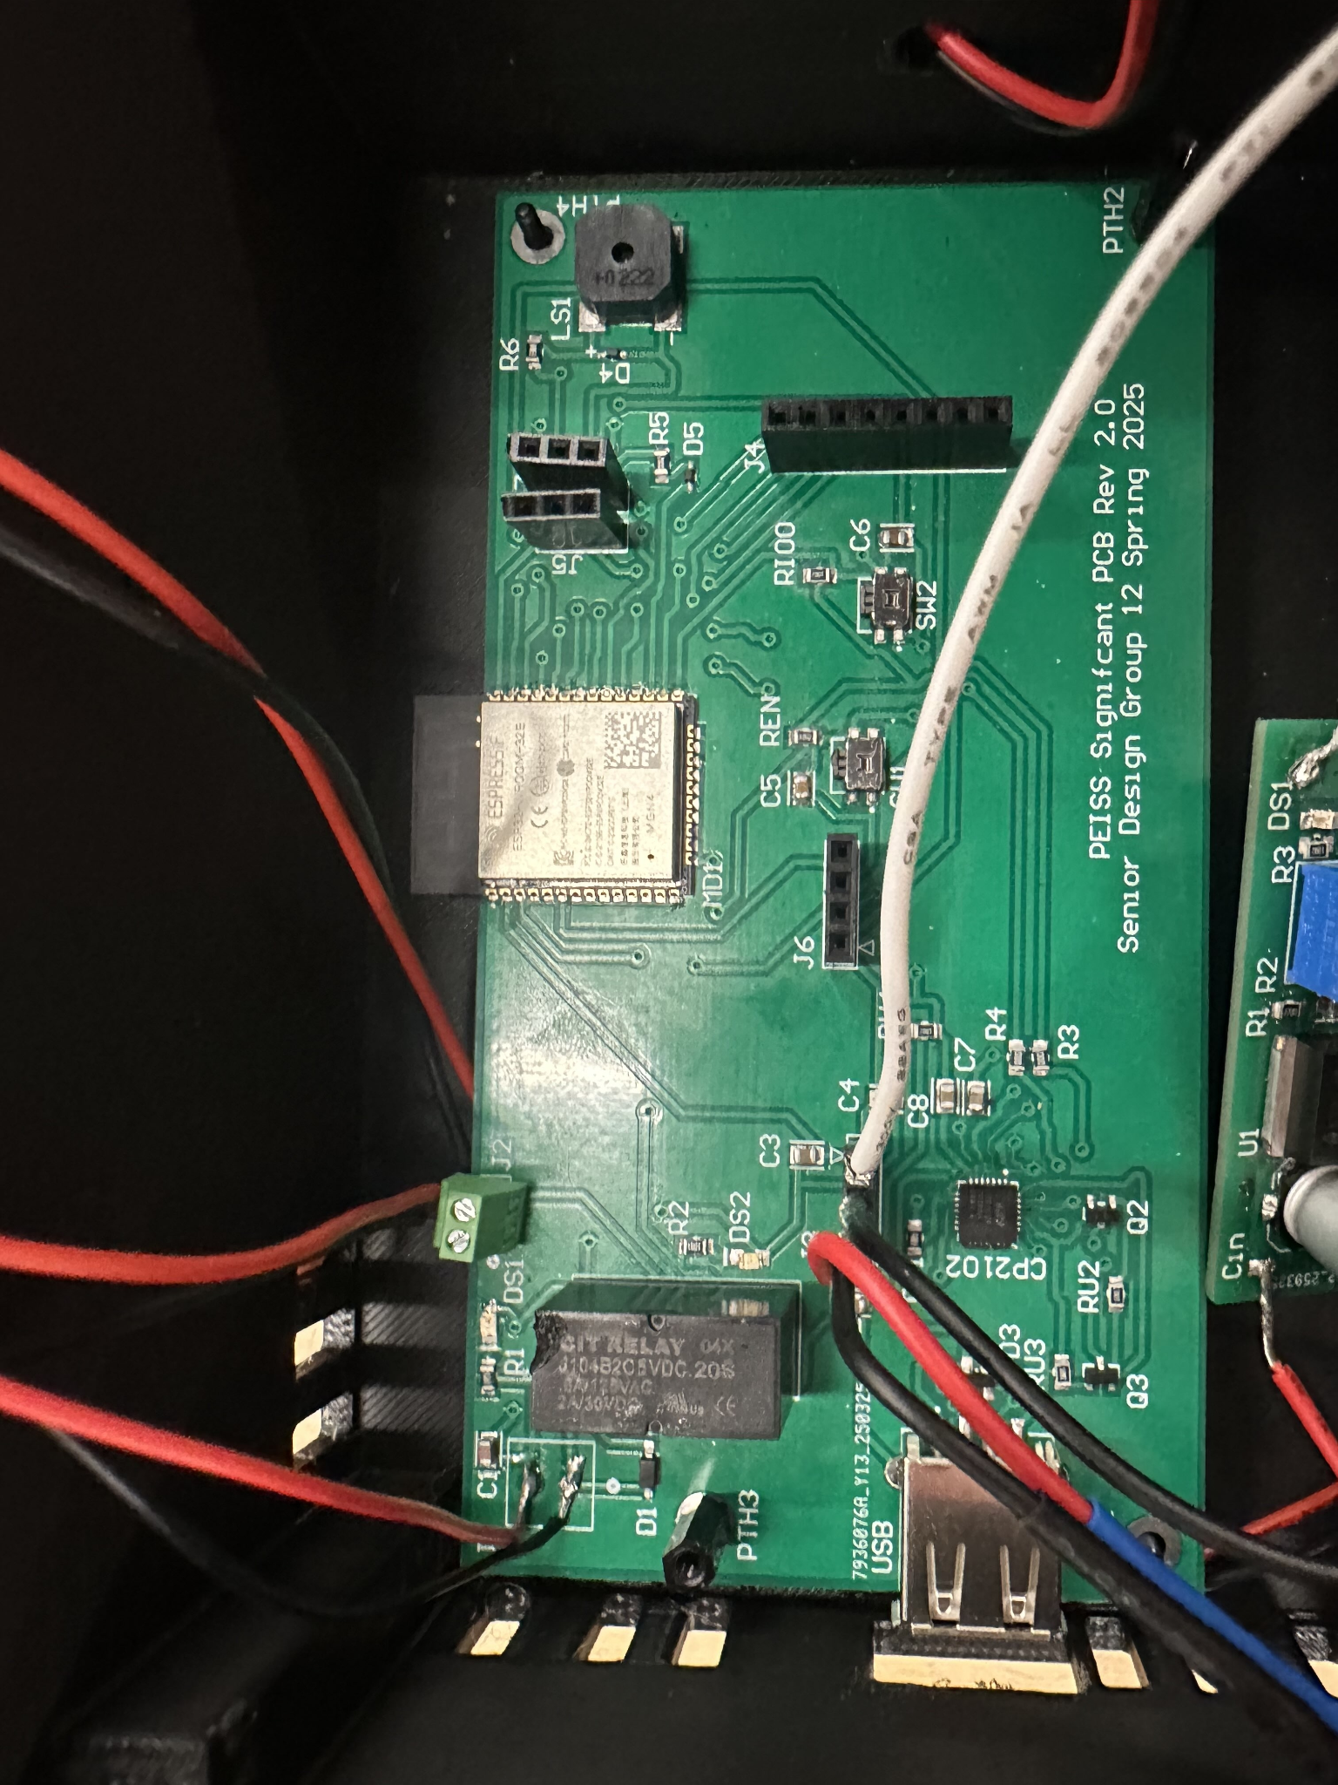
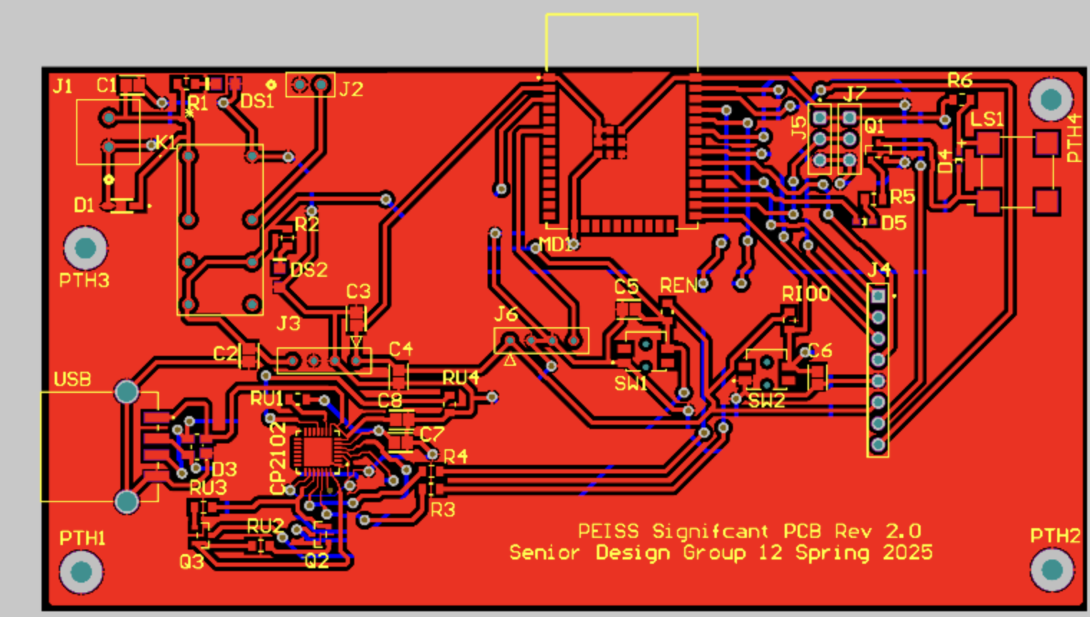
Main PCB

Slide 27
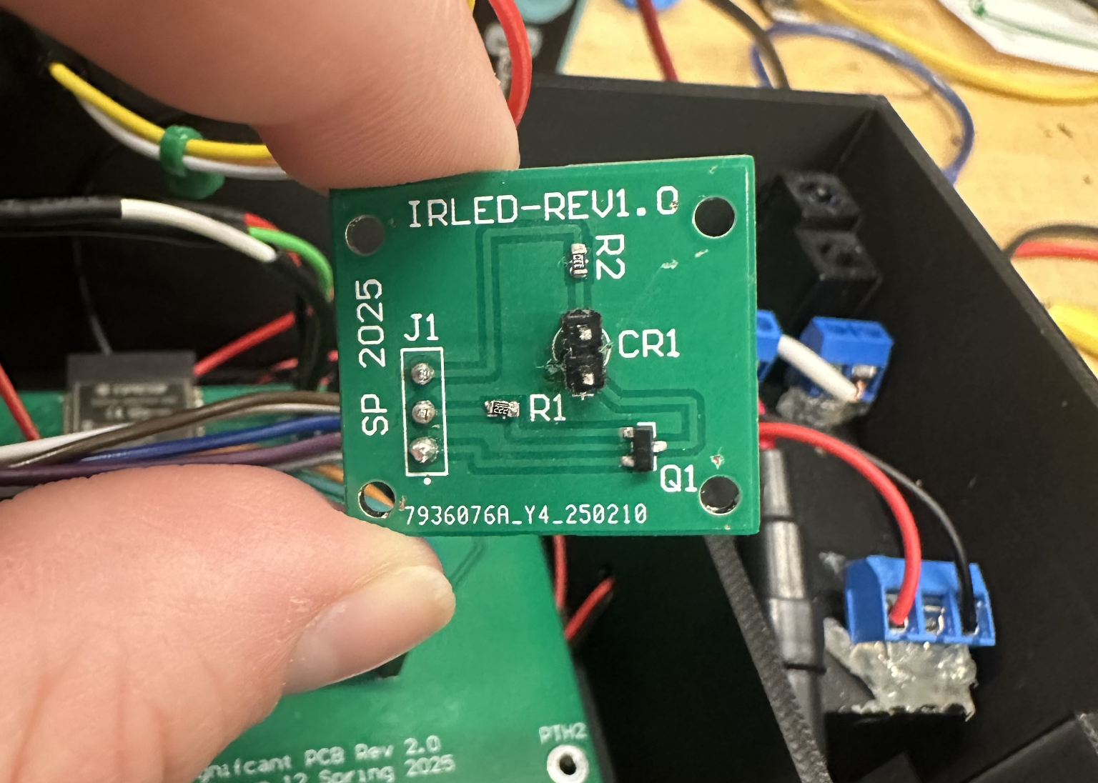
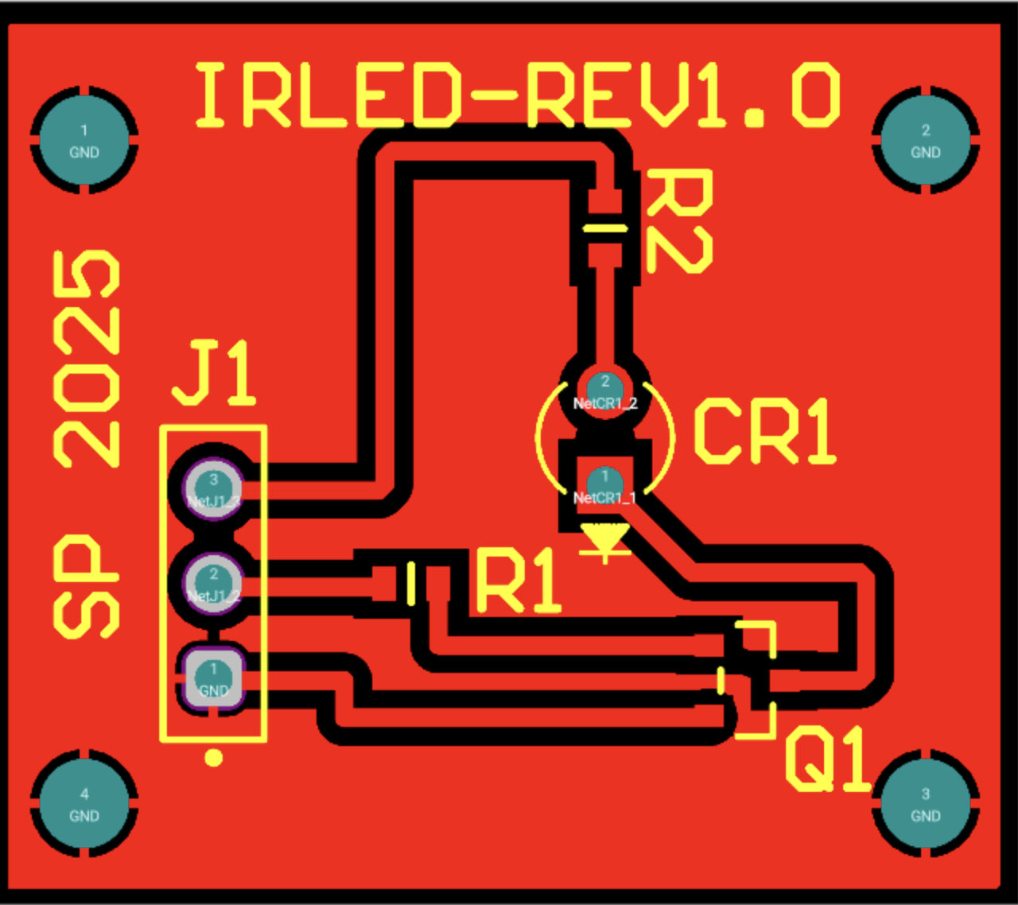
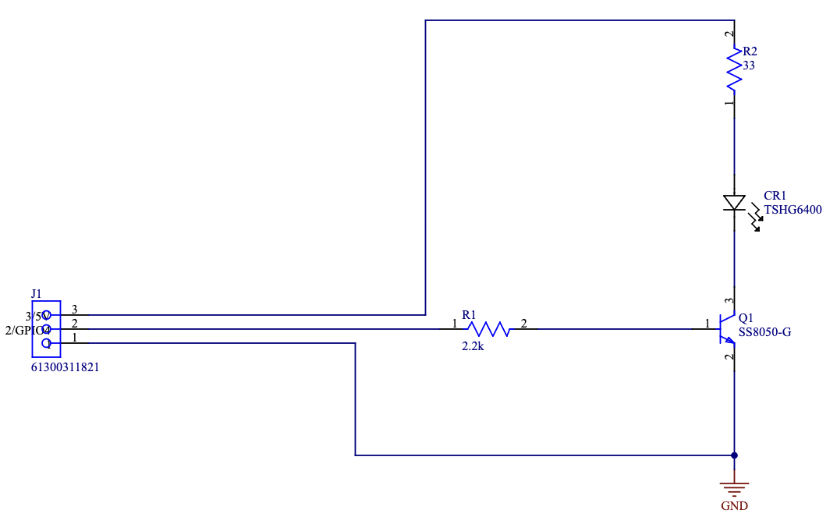
IR-LED board

Slide 28
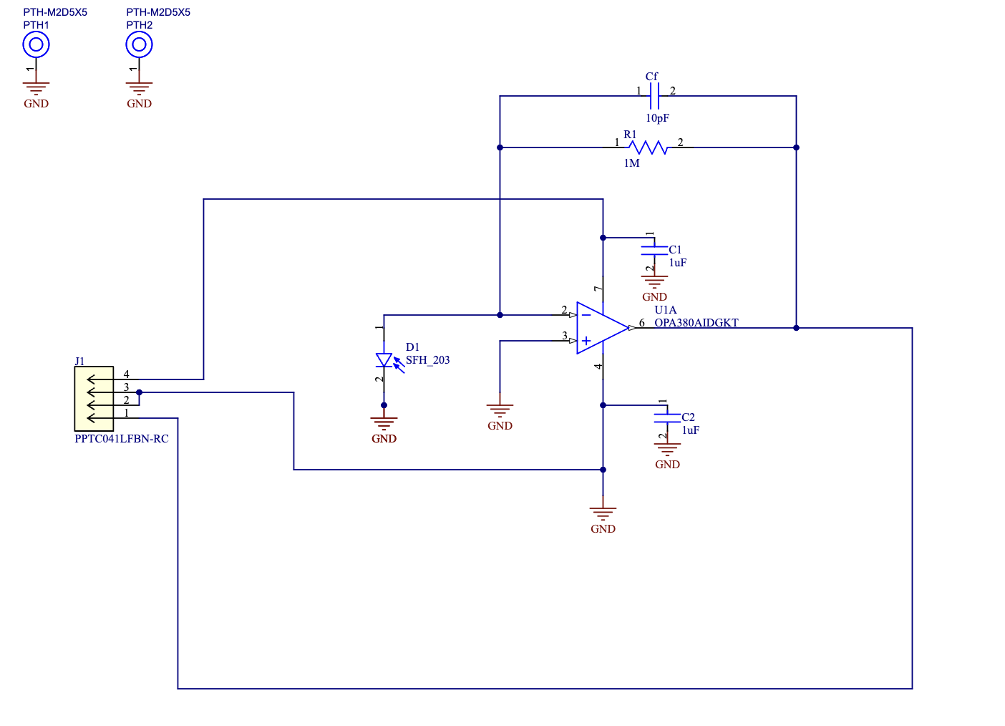
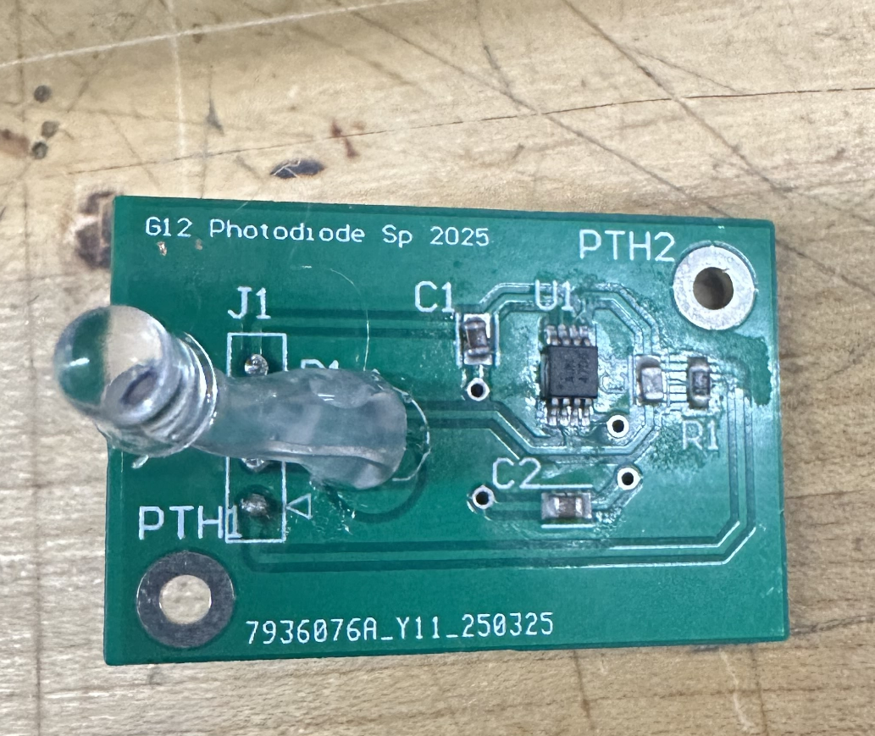
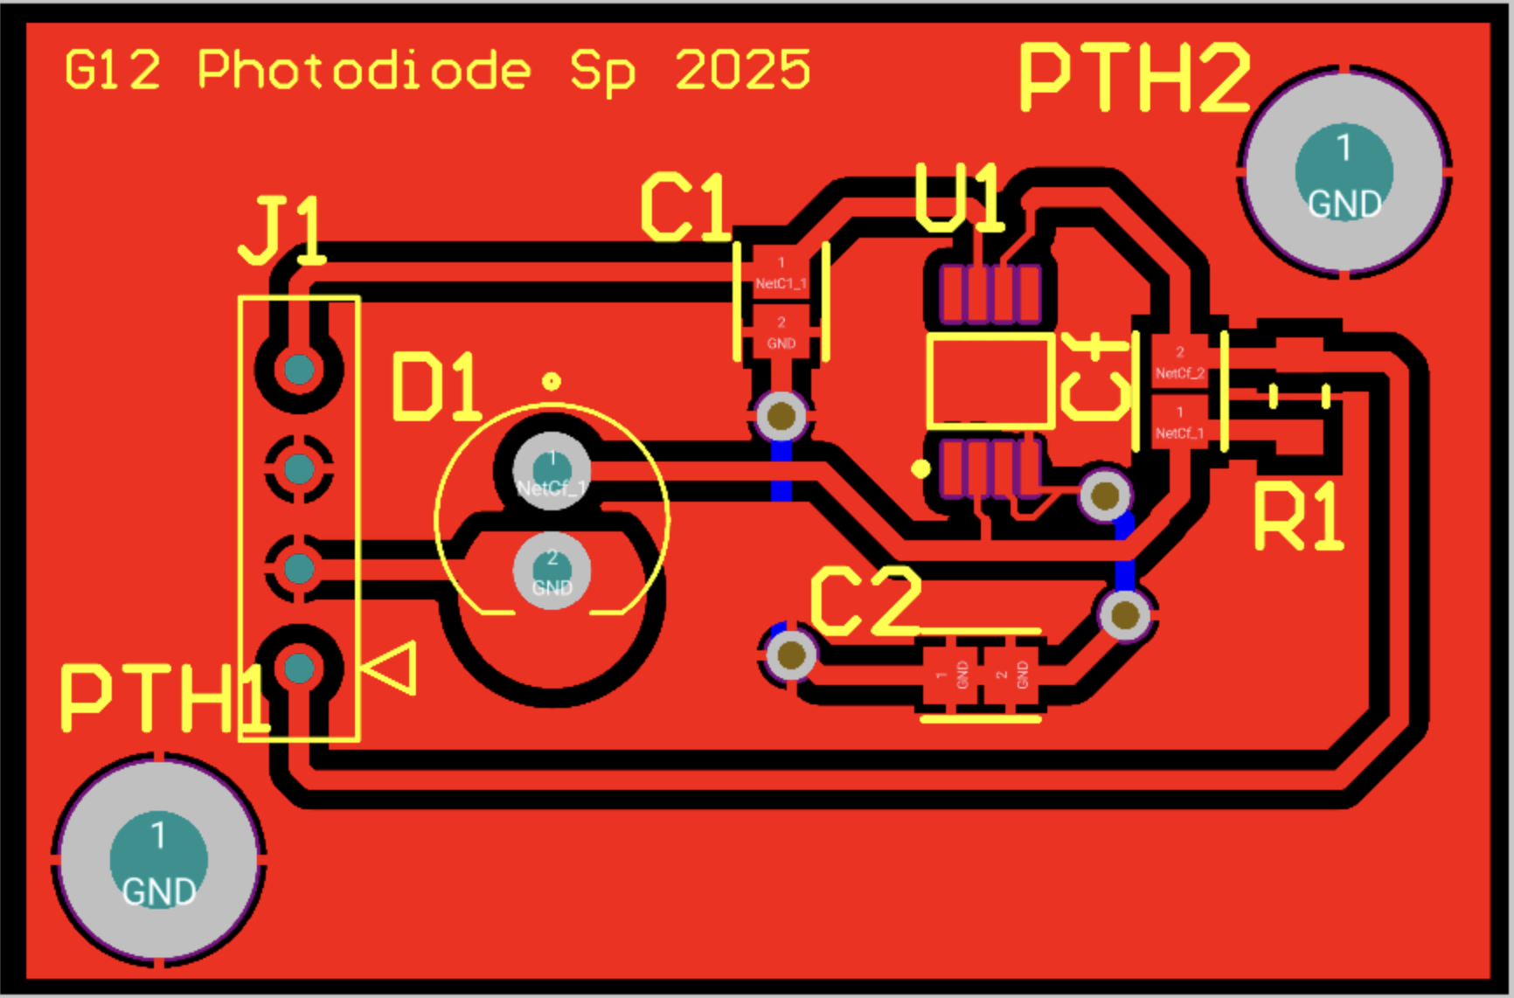
Photodiode board

Slide 29
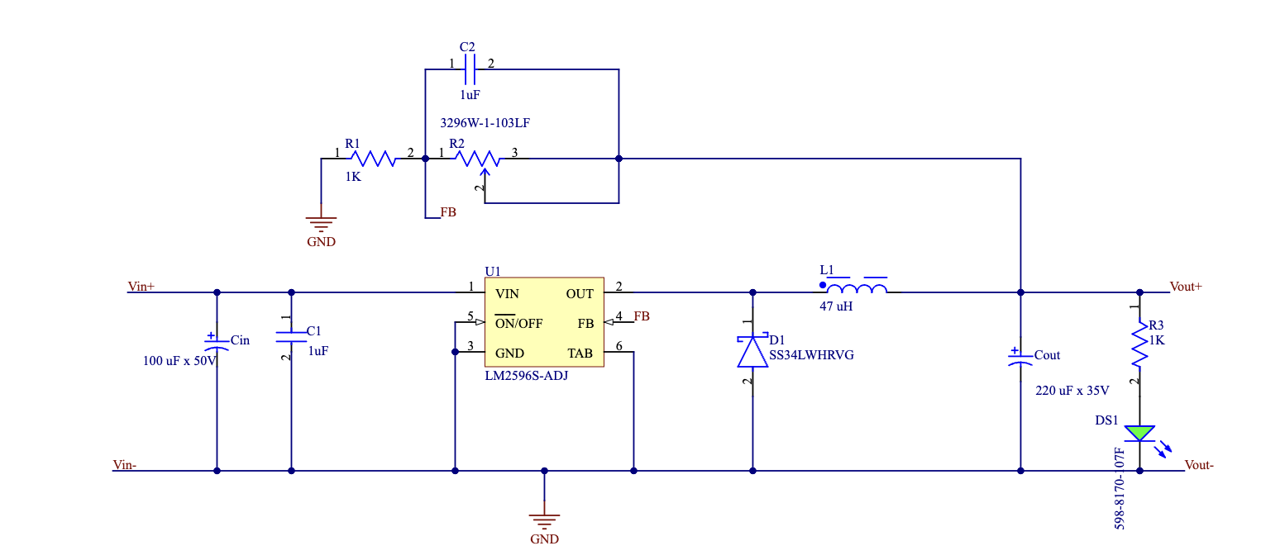
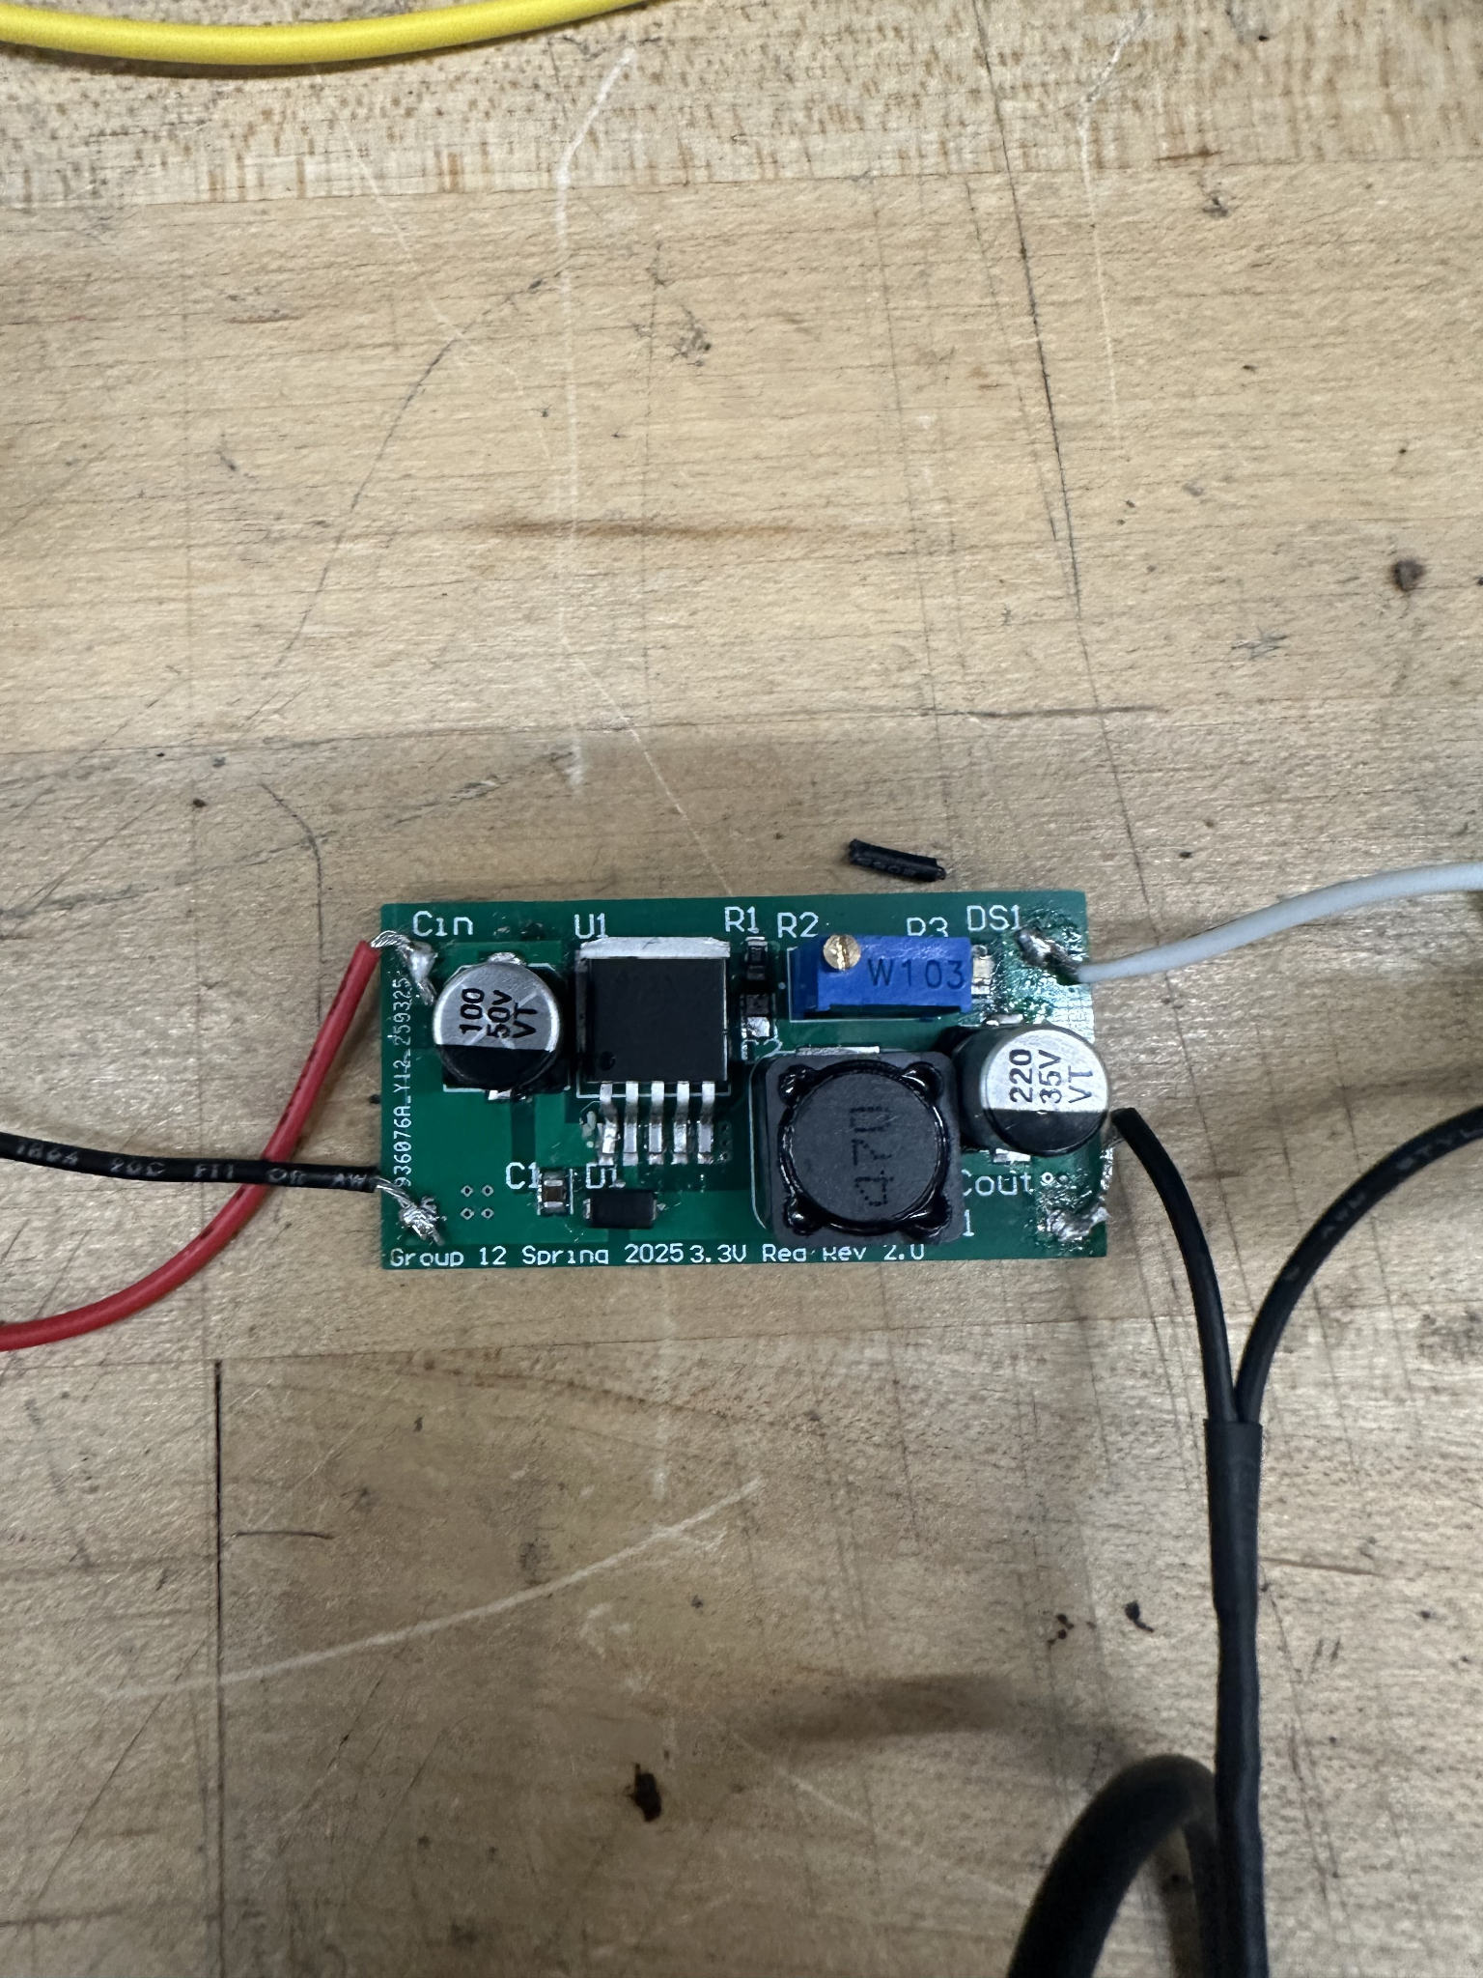
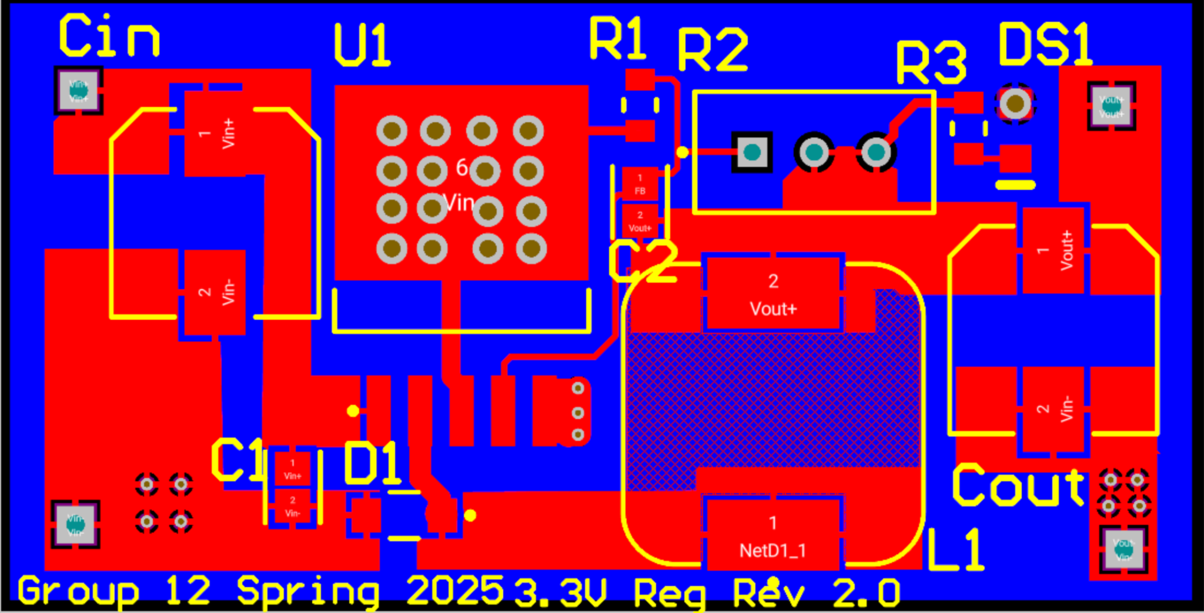
3.3V regulator

Slide 30
Communication Protocol Selection
Protocol | UART | I2C | SPI | USB | Wi-Fi | Bluetooth | LoRaWAN
Connection | Serial | Serial | Serial | Wired | Wireless | Wireless | Wireless
Range | Short distance | Short distance | Short distance | Varying distance up to 9.8 ft | ~100 meters (330 ft) | ~100 meters (330 ft) | Up to 15 km in rural settings and 2-5 in urban
Power Consumption | Low (~5-10 mW) | Low (~1-20 mW) | Low to Moderate (~10-50 mW) | High - 4.5 W (max) | High (50-800 mW) depending on activity | Low (~1-10 mW) | Low (~50-100 µW in idle, ~10-50 mW during transmission)
Transfer Speed | 9600 bps | 100 Kbps, up to 3.4 Mbps if in high speed mode | 10-20 Mbps | 20 Gbps (USB 3.0) | (450-600 Mbps) -2.4 GHz | BLE - 2 Mbps Classic - 1Mbps | 0.3-50 Kbps
UART will be used to program the ESP32.
SPI is the serial communication utilized by the OV2640 camera module.
Wi-Fi will be used to wirelessly communicate between our ESP32 and server hosting the UI.

Slide 31
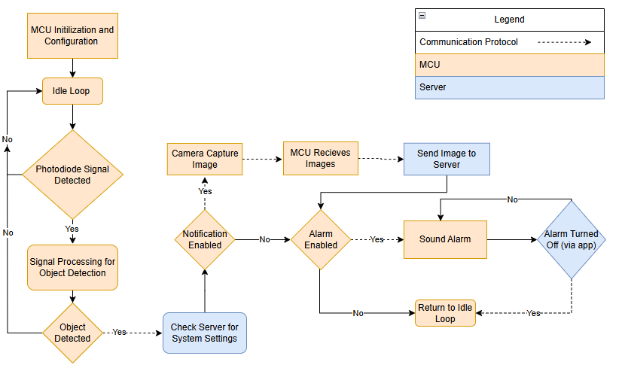

Software MCU Programming
Arduino IDE
C language
Notes:
Matthew

Slide 32
Software Backend (Server)
 | Amazon Web Services | Digital Ocean | Heroku | Google Cloud Platform
Scalability | Highly Scalable | Moderate Scalability | Low Scalability | Highly Scalable
Latency | Very Low Latency | Low Latency | Moderate Latency | Very Low Latency
Uptime Reliability | Very High Reliability | Very High Reliability | Moderate Reliability | Very High Reliability
Ease of Use | Moderate Complexity | Low Complexity | Very Low Complexity | Moderate Complexity
DigitalOcean was chosen due to low complexity and provided high enough reliability and latency for this project
Notes:
Matthew

Slide 33

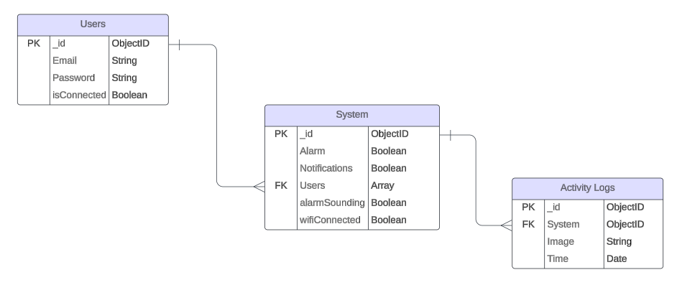
Software Backend (Database)
MongoDB
NoSQL Database
  Faster than other NOSQL DB
  Lot of Past Experience
JSON-like Format Storage
  Easier integration with APIs
Notes:
Matthew

Slide 34

Software Backend (API)
Node.js
Provides the environments to run Javascript to server
Express.js
Framework that allows defining routes for handling HTTP requests (POST, GET, DELETE, PUT)
Notes:
Matthew

Slide 35
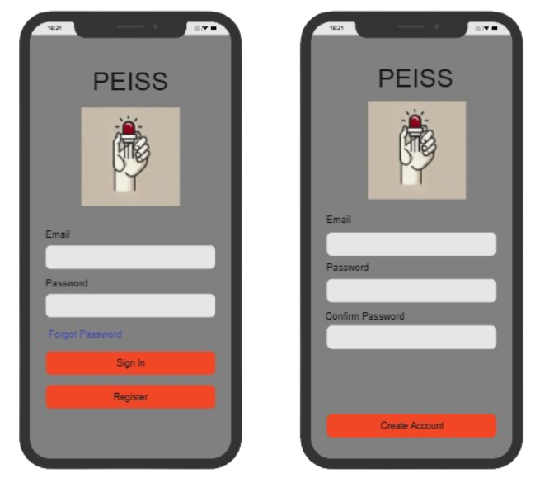

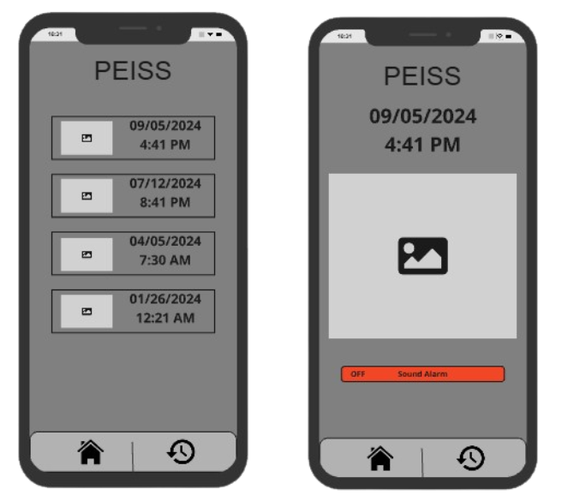
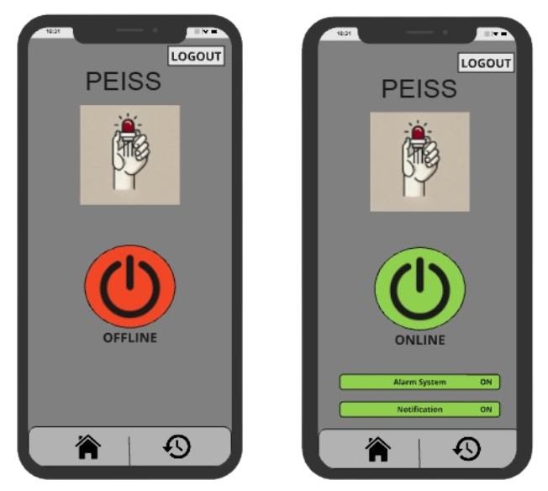
Software Frontend
Flutter
App Framework
Single Codebase for Cross-Platform
Same UI for all Platforms
Notes:
Matthew

Slide 36
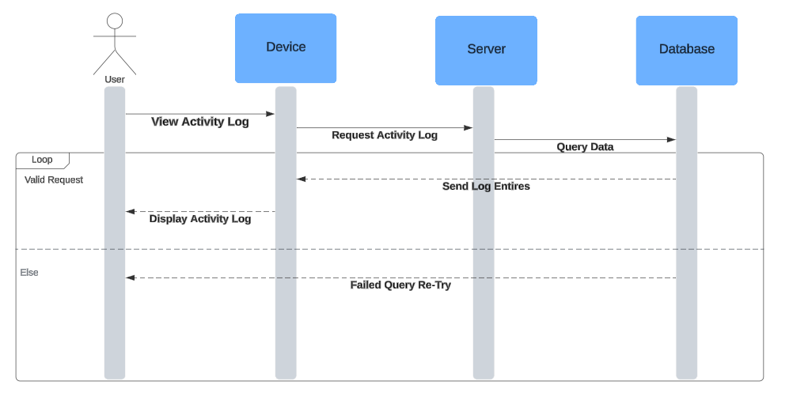
Sequence Diagram
Diagram to display the need for a cloud server. (Ex. Viewing Activity Logs)
Every action done in app needs server as intermediary to database
Notes:
Matthew

Slide 37
Budget
Component Name | Price (USD) | Quantity | Subtotal
Photodiode | $2.60 | 1 | $2.60
LED | $3.00 | 2 | $6.00
Filter | $35.00 | 1 | $35.00
Camera Module | $25.99 | 1 | $25.99
AC-DC Convertor | $9.73 | 1 | $9.73
Battery | $6.95 | 4 | $27.80
Battery Holder | $9.90 | 1 | $9.90
Relay | $3.30 | 1 | $3.30
Regulator | $6.70 | 1 | $6.70
ESP32-WROOM-32E | $2.50 | 1 | $2.50
Total |  |  | $129.52
Notes:
Andrew F

Slide 38
Work Distribution
Member Name | Tasks
Andrew Forde | PCB Design Hardware Integration Snapshot Technology Integration Hardware Testing
Carlos Granja Angulo | Optical System Design Optical System Integration Sensor Calibration and Alignment Optical Enclosure Design
Matthew Berasa | MCU Programming Mobile App Frontend Development Backend Development Signal Processing
Andrew Topliffe | Power System Design AC Power System Design DC Hardware Integration Main Housing Design/Integration
Notes:
Matthew

Slide 39
Future Improvements
Add array of IR LED–photodiode pairs for wider coverage or design modular sensors that you can place in different areas.
Camera FOV Expansion by swapping in wide-angle lens (120°–160°) for current OV2640 or add second angled camera to eliminate blind spots.
Add solar charging option for system
Machine learning-based adaptive filtering: Adjusts sensitivity based on room conditions (e.g., time of day, movement patterns)

